Slide 1
Improve IT service delivery to federal departments
Use Data Analysis to discover the major reasons that cause long incident resolution times

Slide 2
Motivation
Finding out the main reason that causes an incident to take too long to be resolved.
Learning this could help SSC increase the efficiency of their services, which would in turn make federal departments more efficient.

Slide 3
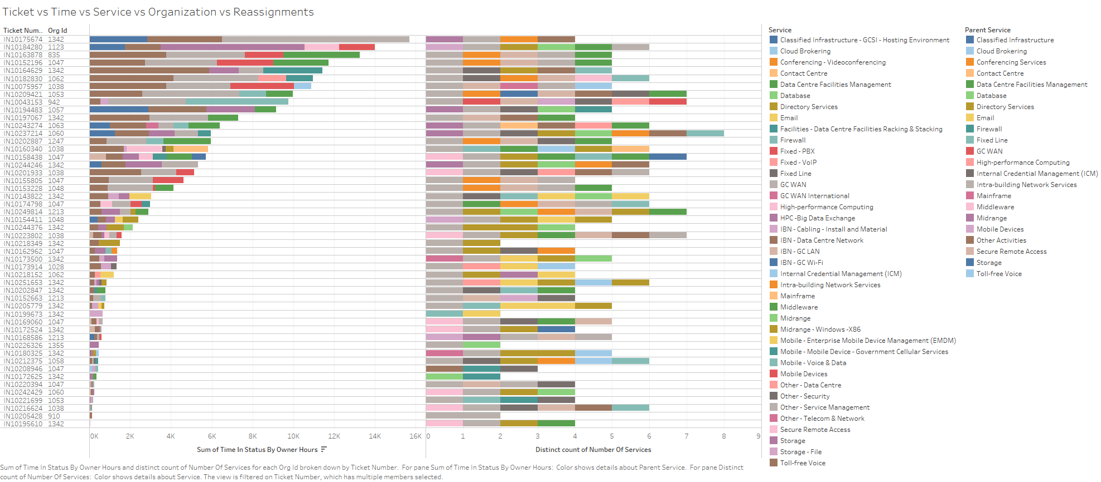
How many services work on the longest tickets?
…
Show the result and explain does re-assigning affect the length of the ticket
…

Slide 4
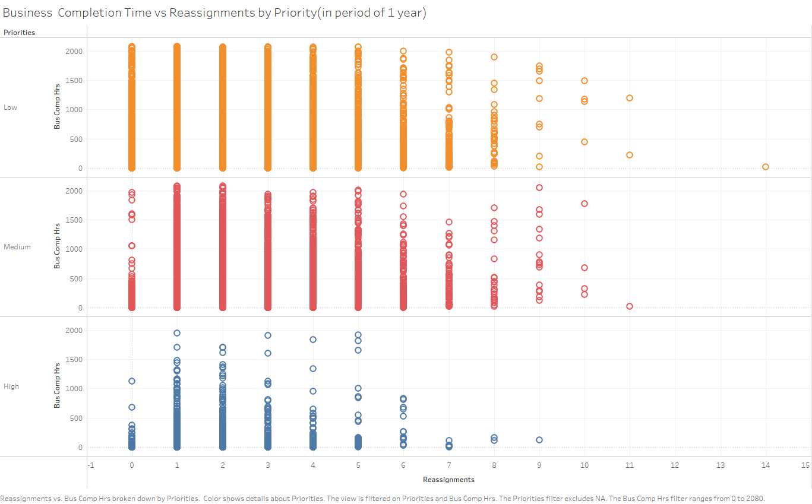
Correlation between reassignments and completion time
Low Priority: r = 0.2334189; Medium Priority: r =0.2433998; High Priority: r = 0.1807678

Slide 5
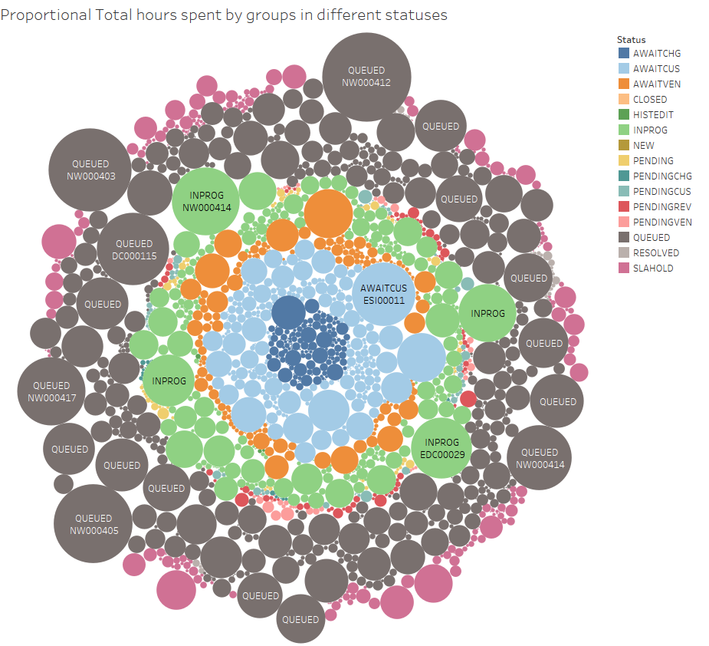
Correlation of STATUS spending hours and Total hours
The time spent in “Queued” and “In Progress” had the greatest effect on extending total hours.

Slide 6
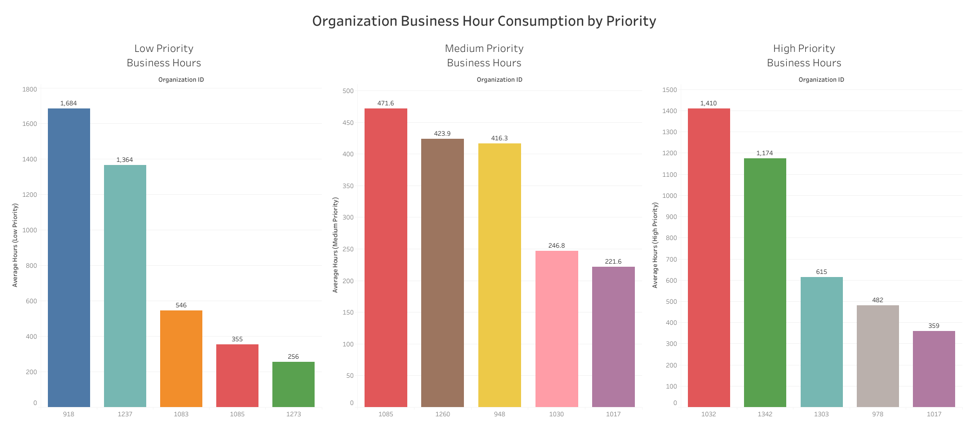
Which Organizations Require the Most Time?

Slide 7
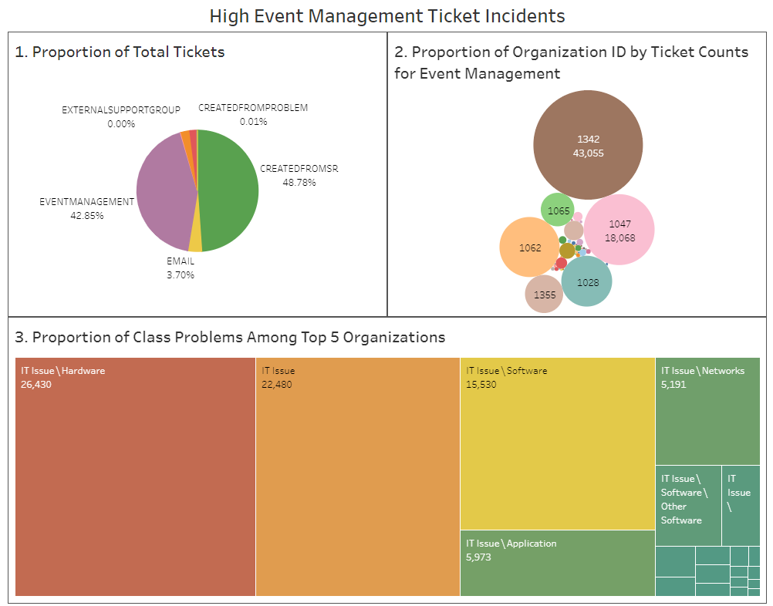
Event Management
Key Points
43% of total tickets are event management
Top 5 organizations are 91% of event management tickets
Hardware and Software are critical problems of top 5 organizations

Slide 8
Conclusion
Conclude the MAIN REASONS that may cause tickets to consume a significant amount of time:
Majority of time was spent on “Queued” and “In Progress”.
These Organizations had majority of the tickets with the most of the reassignments for the long period of time to resolve the issue:
1342, 1062, 1047, 1028
Most of the tickets in Low and Medium priority were reassigned the most and takes longer period of time to resolve them.
These Organizations spent most of their business time to resolve the incidents
Low: 918, 1237 Medium: 1085, 1260, 948 High: 1032, 1342
Majority of the tickets were related with Hardware and Software issues.
There is a weak correlation between the number of reassignments and the business completion hours.

Slide 9
Suggestions
What can SSC do to provide better service?
Improve the queueing process to make sure the tickets are assigned to a group faster.
Investigate the issues of the organizations which have the most re-assignments and tickets as they are impacting the resolution time.
Investigate groups under “Other Activities” category to understand why they have majority of the tickets. Model needs to be created and existing services to be overviewed to reassign those tickets to proper services.
Invest into IT infrastructure for event management tickets of key organizations could possibly reduce 40% of incoming incidents.

